Slide 1

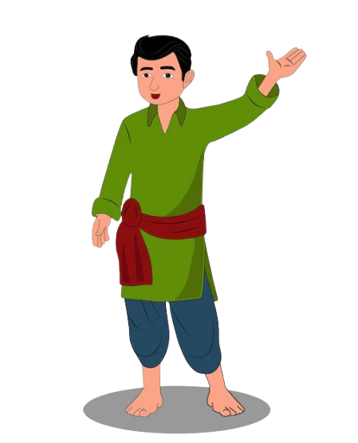
MY VILLAGE

Slide 2
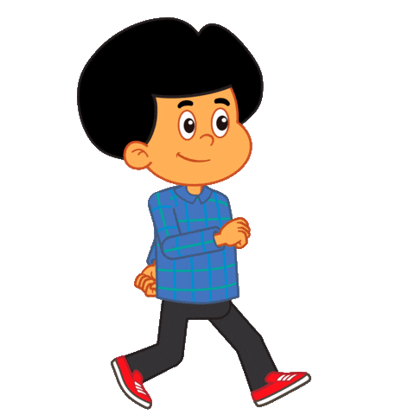
GOING TO SCHOOL

